Slide 1


WELCOME
Be smart traveler

Slide 2
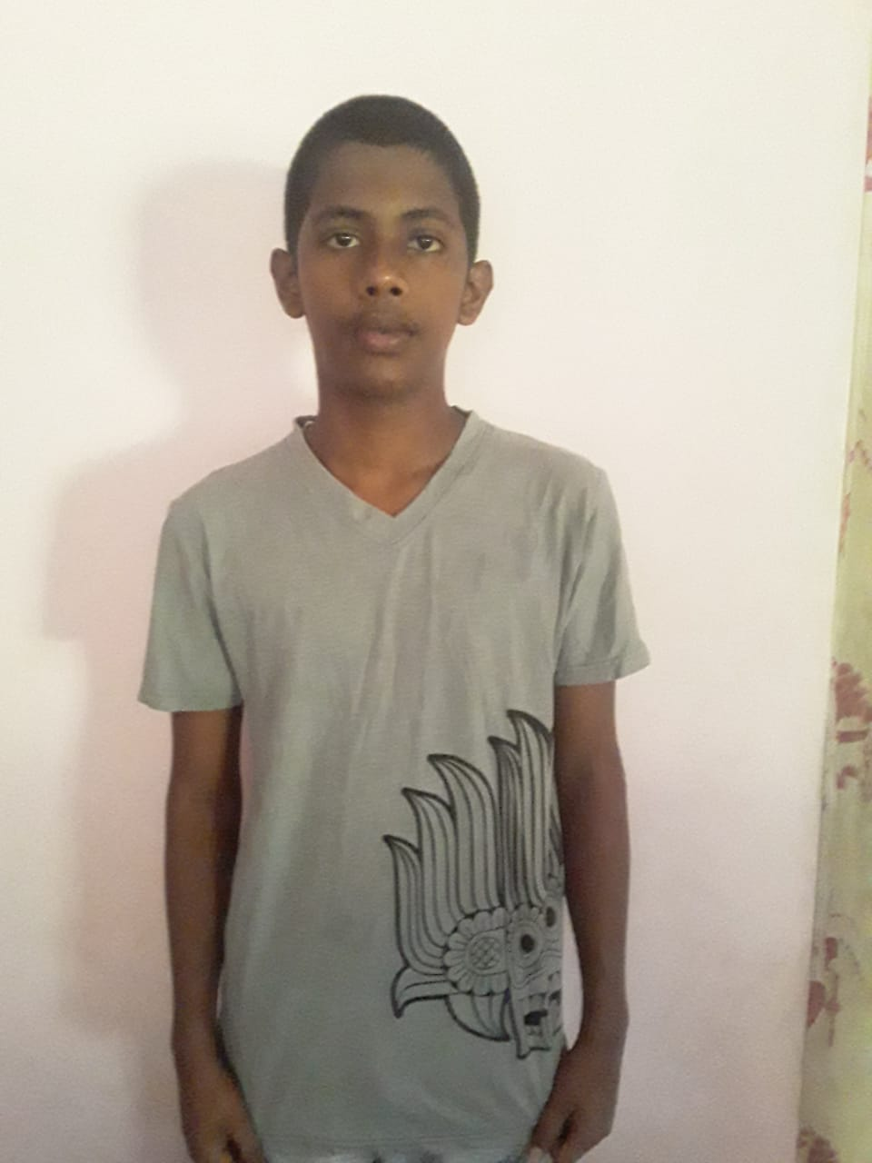

Our Team
Danuka Thimira
Ku/Wayamba Royal College
15 years old
Oshadha Shiro
Nalanda College
12 years old

Slide 3
Our solutions and benefits
Tourists can easily find places of Srilanka.
They can collect some informations about those places.
Tourists can find the timetable and imformation of government transport.
They can find places easily using google maps.

Slide 4
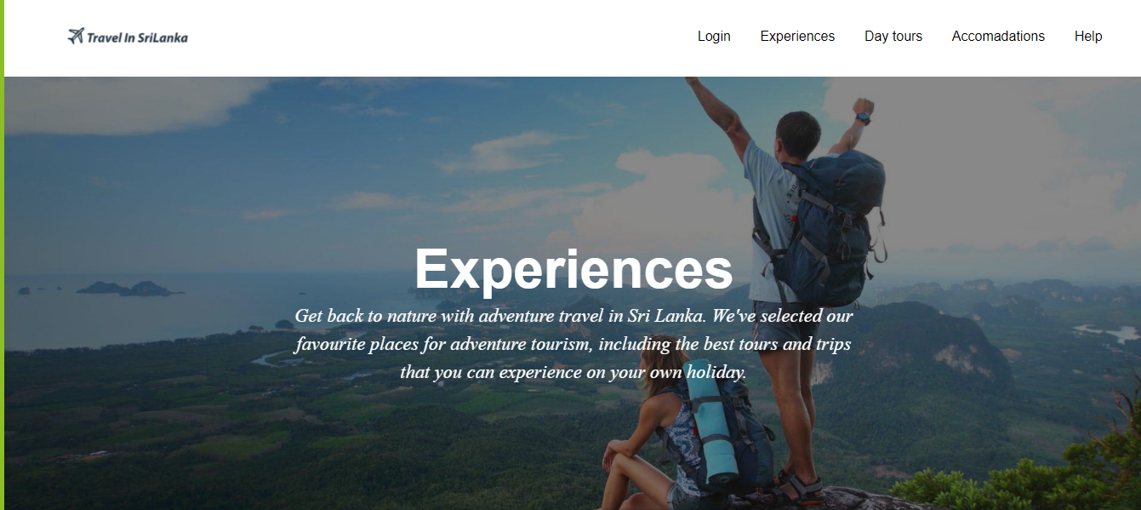
You can watch best experience in Srilanka

Slide 5
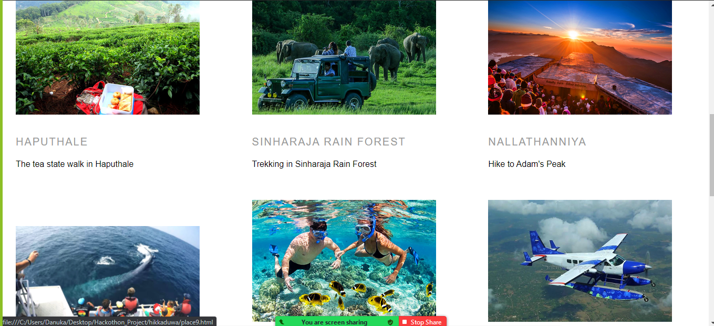
We categorized some places with their information

Slide 6
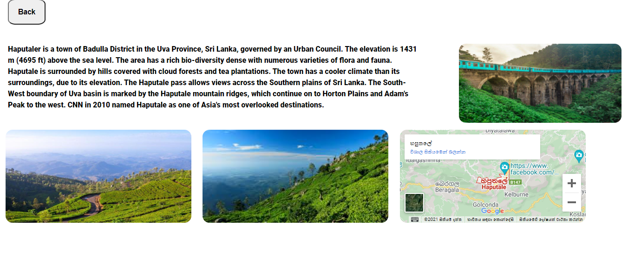
Tourists can easily gather information about some places

Slide 7
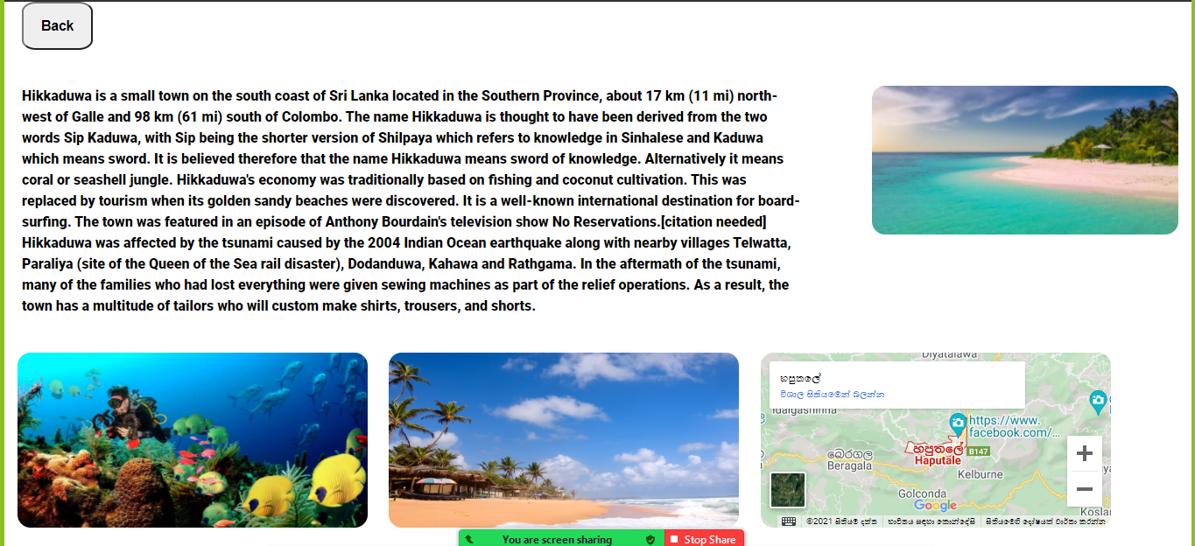
Tourists can also see the google map of the place

Slide 8
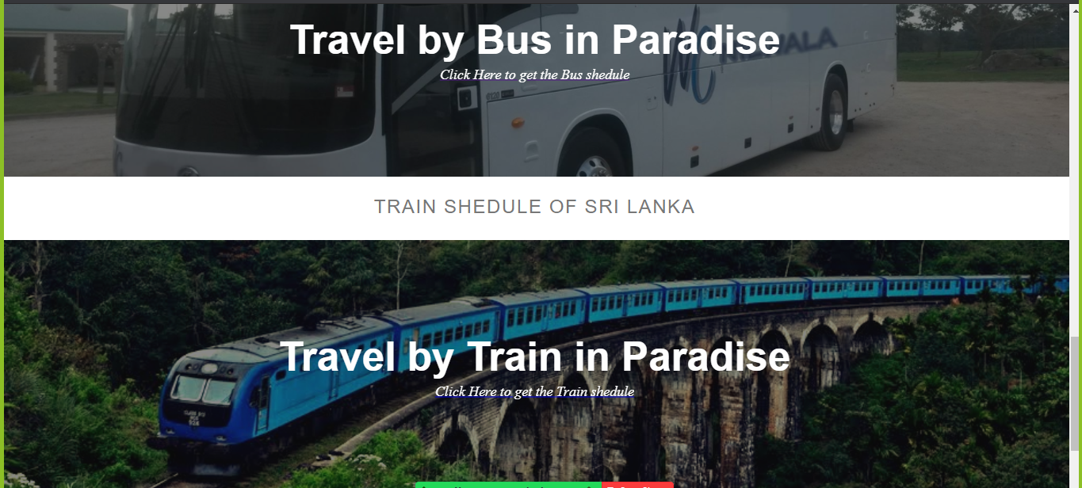
Tourists can see the schedules of buses and trains in our country

Slide 9
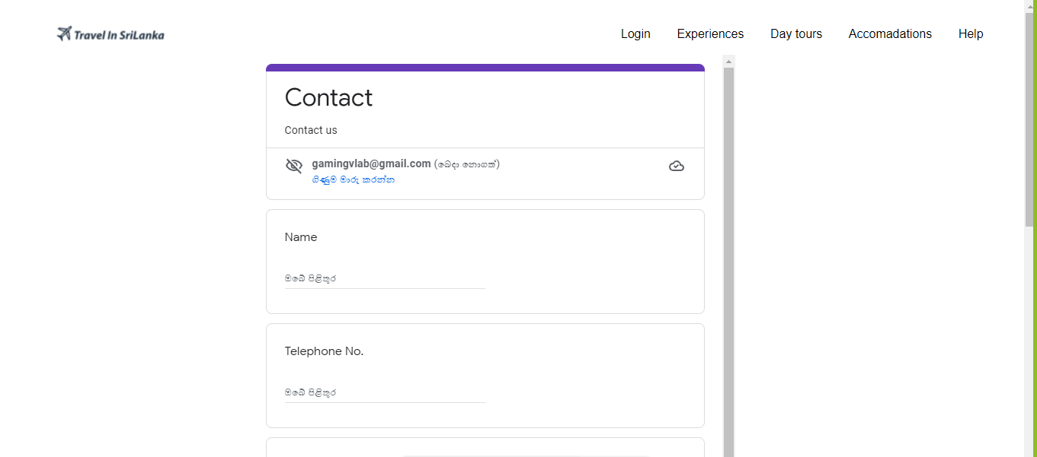
Tourists can share their problems with us

Slide 10
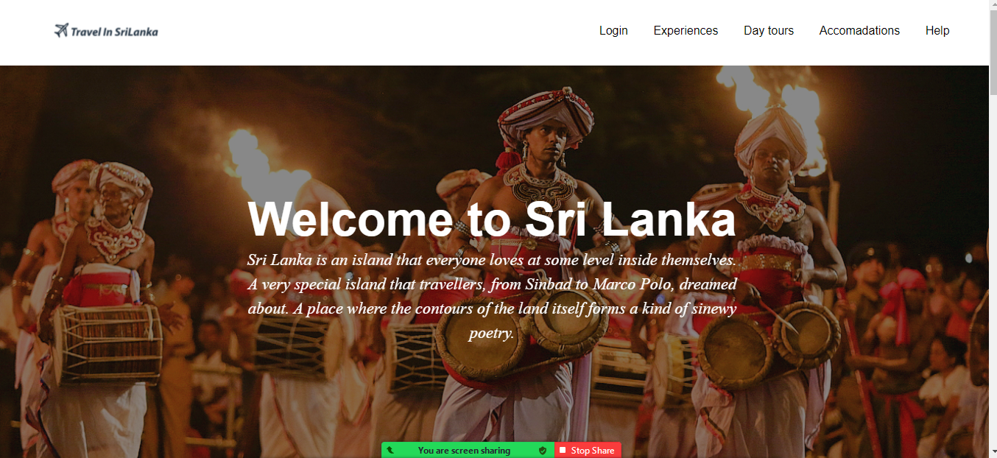
We cover lot of places in Srilanka

Slide 11
Top travelling websites in the world
booking.com
trapidvisor.com
uber.com
airbnb.com
expedia.com

Slide 12
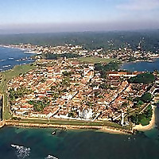




Top travelling websites in srilanka
https://srilankatravelnews.wordpress.com/
https://www.bluelankatours.com/blog
https://www.experiencetravelgroup.com/blog/sri-lanka/
https://www.thesrilankatravelblog.com/
https://wowtovisit.com/

Slide 13



The things we used
HTML
CSS
JAVA SCRIPT

Slide 14
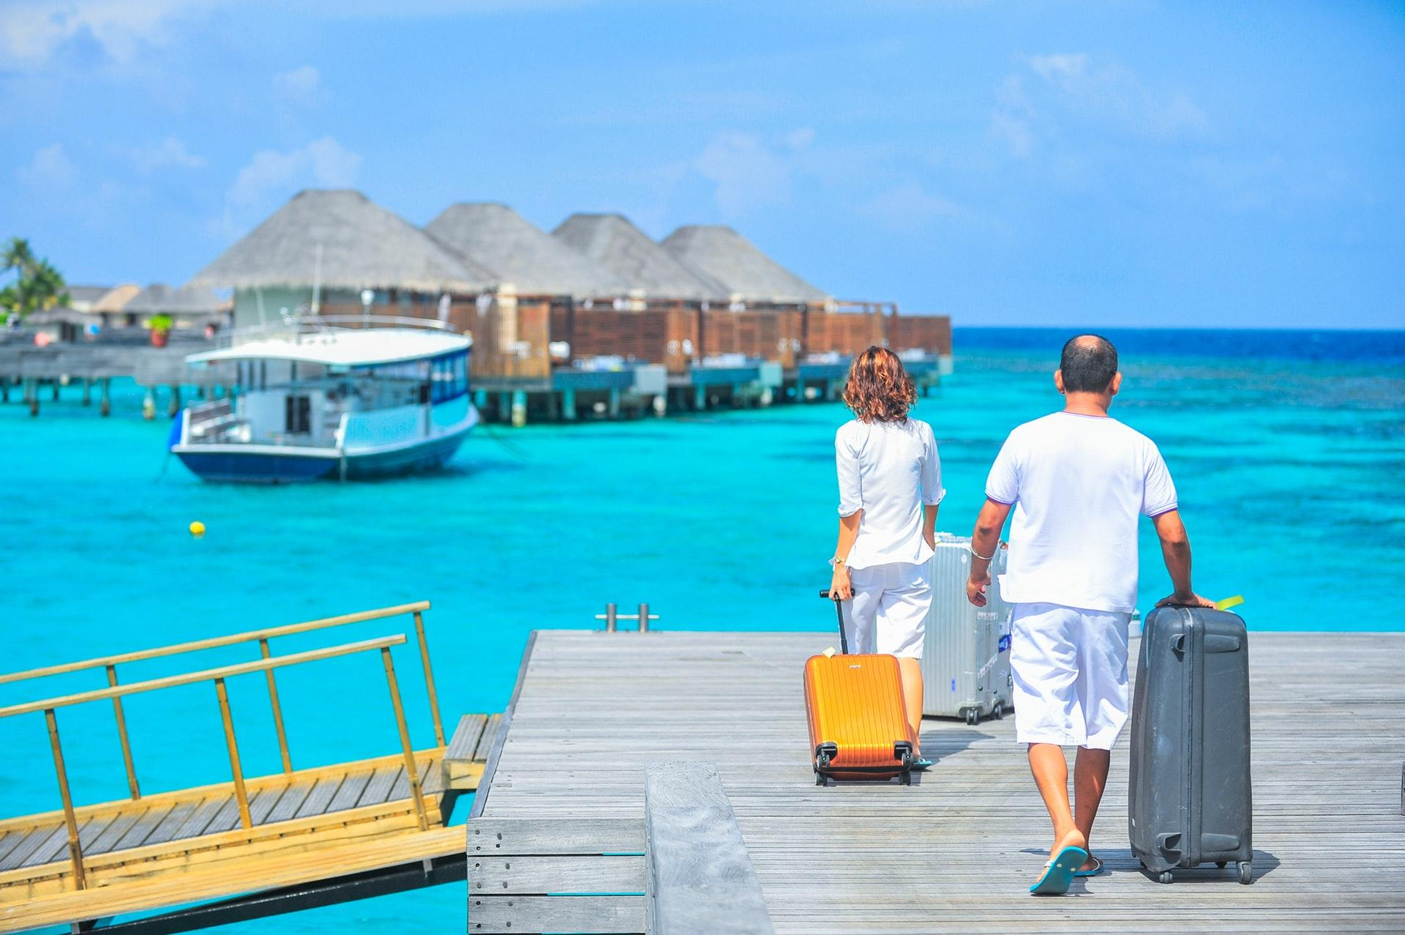
THANK YOU

